Slide 1
Expunction CLE Pisgah Legal Services and the 28th Judicial District Bar LeAnn Melton, Chief Public Defender for Buncombe County November 9, 2017

Slide 2
---Expunctions after Senate Bill 445 ---Certificates of Relief ---Motions for Appropriate Relief ---Expunctions of Juvenile Records

Slide 3
Senate Bill 445----Effective Date: December 1, 2017 and applies to petitions filed on or after that date “AN ACT TO STANDARDIZE THE FILING PROCEDURES FOR EXPUNGEMENTS, TO AUTHORIZE PROSECUTORS ACCESS TO CERTAIN RECORDS OF EXPUNGEMENT, TO ALLOW CERTAIN EXPUNGED CRIMINAL ACTS TO BE CONSIDERED IN CALCULATING PRIOR RECORD LEVELS DURING SENTENCING FOR SUBSEQUENT OFFENSES, AND TO MAKE OTHER MODIFICATIONS TO THE EXPUNGEMENT PROCESS. “
Expunctions after Senate Bill 445
Text of Senate Bill 445.pdf
http://www.ncleg.net/Sessions/2017/Bills/Senate/PDF/S445v5.pdf

Slide 4
Expunctions after Senate Bill 445 Overview of exciting changes: 1. Uniform procedure for filing Petition 2. Petition to be filed with clerk of superior court of county of conviction 3. Petition forwarded by clerk of superior court to Department of Public Safety and the AOC 4. Waiting period to expunge first-time nonviolent felony conviction reduced from 15 years to 10 years

Slide 5
Expunctions after Senate Bill 445 Overview of exciting changes (continued) : 5. 5 year waiting period for a nonviolent misdemeanor conviction 6. All petitions for expunctions have to be on an AOC approved form 7. For dismissed charges or findings of not guilty removes the requirement of “same 12 month period of time” and “prior expungement” disqualification.

Slide 6
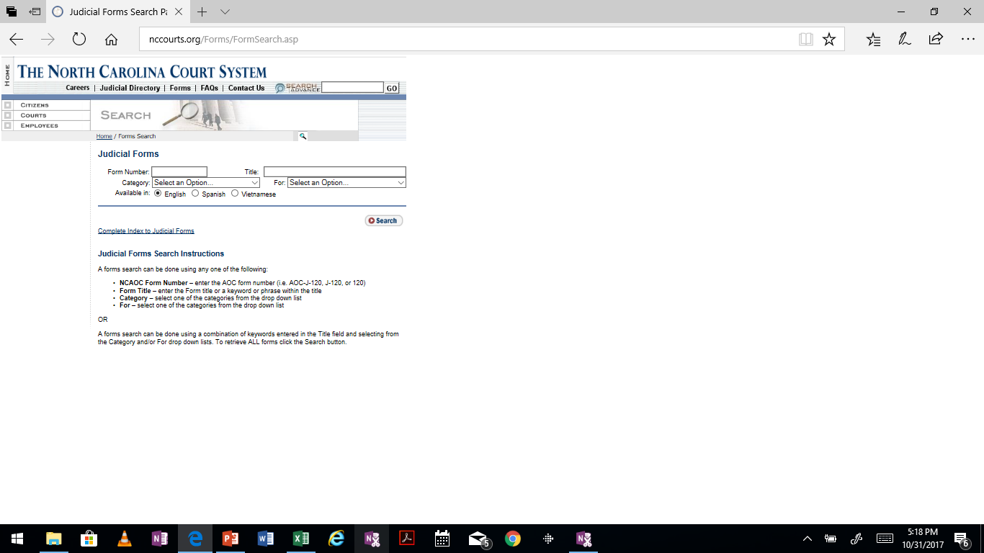
Expunctions after Senate Bill 445 New AOC application forms have not been published yet -- Will be available at below link when published: http://nccourts.org/Forms/FormSearch.asp

Slide 7
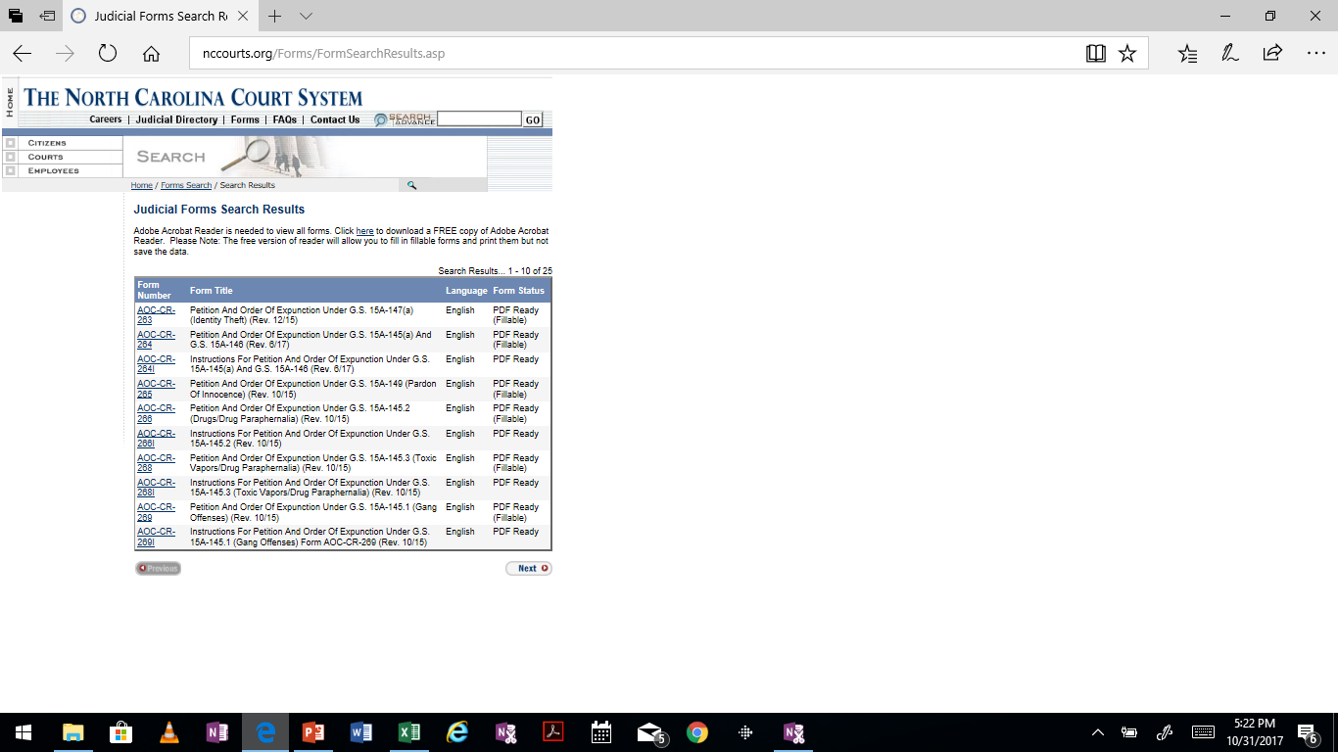
Current List of AOC forms:

Slide 8
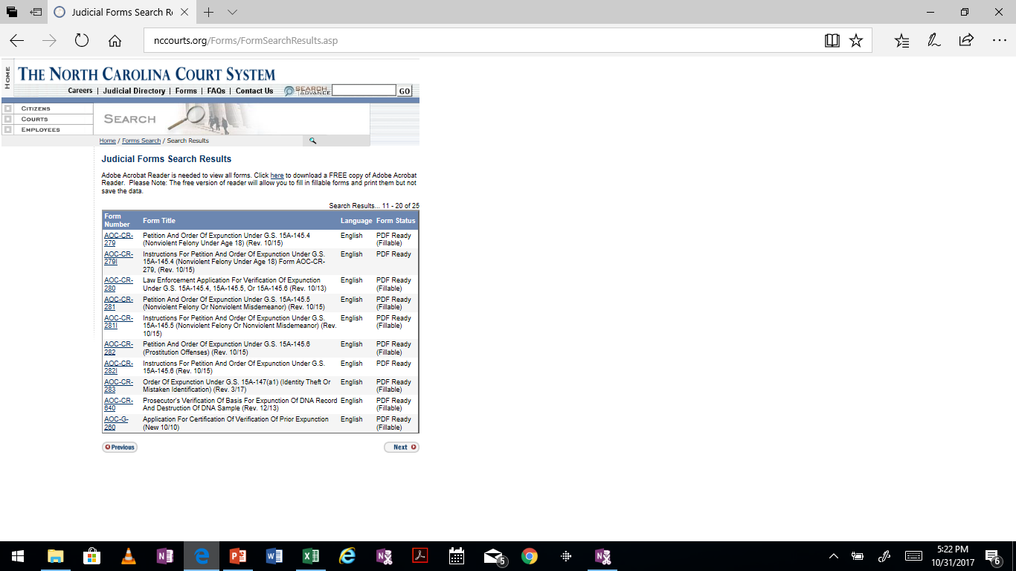
Current List of AOC forms:

Slide 9
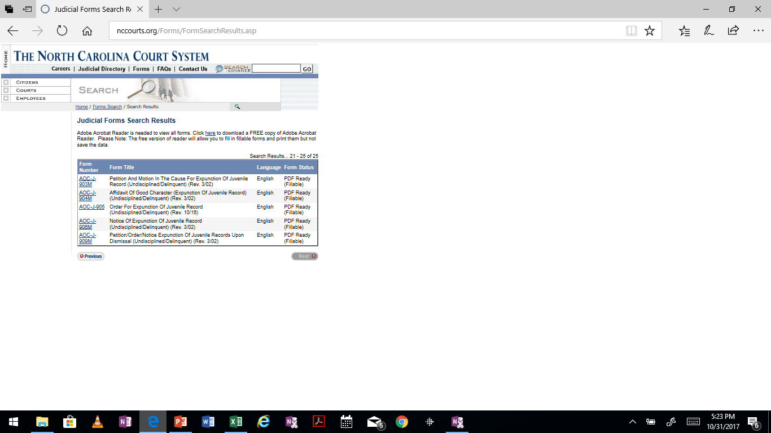
Current List of AOC forms:

Slide 10
ADDITIONAL RESOURCES:
Expunctions after Senate Bill 445
Clerks Conference Materials August 2017.pdf
(Explains clerks procedures under new law)
http://www.ncjustice.org/?q=second-chance-alliance/summary-nc-expunctions-2017
(Great summary of expunction procedures in North Carolina and includes sample affidavits)
https://www.sog.unc.edu/resources/microsites/relief-criminal-conviction
(Guide explaining all of the different ways to obtain relief from criminal conviction in north Carolina)
http://ccat.sog.unc.edu/
(Collateral consequences assessment tool)

Slide 11
Expunctions after Senate Bill 445
To determine what Statute to proceed under
Run statewide criminal record check
CIPRS at Clerk’s Office
ACIS at Clerk’s Office
SBI –Right to Review Form:
https://files.nc.gov/ncdps/div/SBI/Forms/SBIRight-to-Review.pdf
Certified Copy from Clerk’s Office

Slide 12
Expunctions after Senate Bill 445
15A-145 Expunction of records for first offenders under the age of 18 at the time of conviction of misdemeanor; expunction of certain other misdemeanors.
15A-145.1 Expunction of records for first offenders under the age of 18 at the time of conviction of certain gang offenses.
15A-145.2 Expunction of records for first offenders not over 21 years of age at the time of the offense of certain drug offenses.
15A-145.3 Expunction of records for first offenders not over 21 years of age at the time of the offense of certain toxic vapors offenses.
15A-145.4 Expunction of records for first offenders who are under 18 years of age at the time of the commission of a nonviolent felony.
15A-145.5 Expunction of certain misdemeanors and felonies; no age limitation.
15A-145.6 Expunctions for certain defendants convicted of prostitution.
15A-146 Expunction of records when charges are dismissed or there are findings of not guilty.
15A-147 Expunction of records when charges are dismissed or there are findings of not guilty as a result of identity theft or mistaken identity.
15A-148 Expunction of DNA records when charges are dismissed on appeal or pardon of innocence is granted.
15A-149. Expunction of records when pardon of innocence is granted.

Slide 13
§15A-145---Expunctions of records for first offenders under the age of 18 at the time of conviction of misdemeanor; expunction of certain other misdemeanors.
Requirements:
Must “…not have previously been convicted of any felony or misdemeanor other than a traffic violation, under the law of the United States, the laws of this State or any state…”
Charge plead guilty to or is found guilty of “a misdemeanor other than a traffic violation and the offense was committed before the person attained the age of 18 years or …pleads guilty to or is guilty of a misdemeanor possession of alcohol pursuant to G.S. 18B-302(b)(1), and the offense was committed before the person attained 21 years”
Petition is filed “….in the court of the county where he was convicted for expunction of the misdemeanor from his criminal record.”
Petition “cannot be filed earlier than: (i) two years after the date of conviction, or (ii) the completion of any period of probation, whichever occurs later..”

Slide 14
§15A-145---Expunctions of records for first offenders under the age of 18 at the time of conviction of misdemeanor; expunction of certain other misdemeanors.
Requirements of Petition:
An affidavit by petition
“Has been of good behavior for the two-year period since the date of conviction of the misdemeanor in question and has not been convicted of any felony, or misdemeanor other than a traffic violation, under the laws of the United States or the laws of this State or any other State.”
“Verified affidavits of two persons who are not related to the petitioner or to each other by blood or marriage, that they know the character and reputation of the petitioner in the community in which he lives and that his character and reputation are good.”
“A statement that the petition is a motion in the cause in the case wherein the petitioner was convicted.”
“An application on a form approved by the Administrative Office of the Courts requesting and authorizing a name-based State and national criminal record check by the Department of Public Safety.”
“The application shall be filed with the clerk of superior court.”
“An affidavit by the petitioner that no restitution orders or civil judgments representing amounts ordered for restitution entered against him are outstanding.”

Slide 15
§15A-145---Expunctions of records for first offenders under the age of 18 at the time of conviction of misdemeanor; expunction of certain other misdemeanors.
Requirements of Petition (continued):
Petition “shall be served upon the district attorney of the court wherein the case was tried resulting in conviction.”
District Attorney “shall have 10 days thereafter in which to file any objection thereto and shall be duly notified as to the date of the hearing of the petition.”
Must pay “the clerk of superior court a fee of one hundred seventy-five ($175.00) at the time the petition is filed.” Fee does not apply to petitions filed as an indigent.
AOC-G-106_Petition to sue as an indigent.pdf
A prior expunction is NOT a bar to relief under this statute.

Slide 16
§15A-145.1-----Expunction of records of first offenders for first offenders under the age of 18 at the time of conviction of certain gang offenses.
Requirements:
Plead guilty to or guilty of “(i) a Class H felony under Article 13A of Chapter 14 of the General Statutes or (ii) an enhanced offense under G.S. 14-50.22, or has been discharged and had the proceedings against the person dismissed pursuant to G.S. 14-50.29, and the offense was committed before the person attained the age of 18 years.”
“Except as provided in G.S. 14-50.29 (Conditional discharge for first offenders under the age of 18) upon discharge and dismissal, the petition cannot be filed earlier than (i) two years after the date of the conviction or (ii) the completion of any period of probation, whichever occurs later.”

Slide 17
§15A-145.1-----Expunction of records of first offenders for first offenders under the age of 18 at the time of conviction of certain gang offenses.
For Petition to be granted Court must find:
15A-145.1 (b)
“(i) the petitioner was dismissed and the proceedings against the petitioner discharged pursuant to G.S. 14-50.29 and the person had not yet attained 18 years of age at the time of the offense or (ii) the petitioner has remained of good behavior and been free of conviction of any felony or misdemeanor other than a traffic violation for two years from the date of conviction of the offense in question the petitioner has no outstanding restitution orders or civil judgments representing amounts ordered for restitution entered against the petitioner, and the petitioner had not attained the age of 18 years at the time of the offense in question…”

Slide 18
§15A-145.1-----Expunction of records of first offenders for first offenders under the age of 18 at the time of conviction of certain gang offenses.
Fee:
$175.00
Fee does not apply “to petitions filed by an indigent”

Slide 19
§15A-145.2—Expunction of records for first offenders not over 21 years of age at the time of offense of certain drug offenses
15A-145.2 (a)
“Whenever a person is discharged, and the proceedings against the person dismissed, pursuant to 90-96(a) or (a)1, and the person was not over 21 years of age at the time of the offense, the person may apply to the court of the county where charged for an order to expunge…”
Requirements:
“(1) An affidavit by the petitioner that he or she has been of good behavior during the period of probation since the decision to defer further proceedings on the offense in question and has not been convicted of any felony or misdemeanor other than a traffic violation under the law of the United States or the laws of this State or any other state:
(2) Verified affidavits by two persons who are not related to the petitioner or to each other by blood or marriage, that they know the character and reputation of the petitioner in the community in which he or she lives, and that the petitioner’s character and reputation are good;
(3) Repealed……
(3a) An application on a form approved by the Administrative Office of the Courts….”

Slide 20
§15A-145.2—Expunction of records for first offenders not over 21 years of age at the time of offense of certain drug offenses
15A-145.2 (b)
“Whenever any person is charged with a misdemeanor under Article 5 of Chapter 90 of the General Statutes by possessing a controlled substance included within Schedules I through VI of Article 5 of Chapter 90 of the General Statutes or a felony under G.S. 90-95(a)(3), upon dismissal by the State of the charges against the person, upon entry of a nolle prosequi, or up finding of not guilty or other adjudication of innocence, such person may apply to the court for an order to expunge…..”
Required findings:
“…such person was not over 21 years of age at the time the offense for which the person was charged occurred, it shall enter such order.”

Slide 21
§15A-145.2—Expunction of records for first offenders not over 21 years of age at the time of offense of certain drug offenses
15A-145.2 (c)
“Whenever any person who has not previously been convicted of (i) any felony offense under any state or federal laws; (ii) any offense under Chapter 90 of the General Statutes; or ( iii) an offense under any statute of the United States or any state relating to controlled substances included in any schedule of Chapter 90 of the General Statutes or to that paraphernalia included in Article 5B of Chapter 90 of the General Statutes, pleads guilty to or has been found guilty of a misdemeanor under Article 5 of Chapter 90 of the General Statutes by possessing a controlled substance included within Schedules I through VI of Chapter 90, or by possessing drug paraphernalia as prohibited by G.S. 90-113.22 or pleads guilty to or has been found guilty of a felony under G.S. 90-95 (a) (3), the court may, upon application of the person not sooner than 12 months after conviction, order cancellation of the judgment of conviction and expunction of the records…… Cancellation and expunction under this subsection may occur only once with respect to any person…”
Required findings:
“…”the petitioner was convicted of (i) a misdemeanor under Article 5 of Chapter 90 of the General Statutes for possessing a controlled substance included within Schedules I through VI of Article 5 of Chapter 90 of the General Statutes or for possessing drug paraphernalia as prohibited in G.S. 90-113.22 or (ii) a felony under G.S. 90-95(a)3, that the petitioner has no disqualifying previous convictions as set forth in this subsection, that the petitioner was not over 21 years of age at the time of the offense, that the petitioner has been of good behavior since his or her conviction, that the petitioner has successfully completed a drug education program approved for this purpose by the Department of Health and Human Services, and the petitioner has not been convicted of a felony or misdemeanor other than a traffic violation under the laws of this State at any time prior to or since the conviction for the offense in question……”

Slide 22
§15A-145.2—Expunction of records for first offenders not over 21 years of age at the time of offense of certain drug offenses
Fee:
$175
Fee does not apply “to petitions filed by an indigent”

Slide 23
§15A-145.3--Expunction of records for first offenders not over 21 years of age at the tie of the offense of certain toxic vapors offenses
15A-145.3 (a)
“Whenever a person is discharged and the proceedings against the person dismissed under G.S. 90-113.14(a) or (a1), such person, if he or she was not over 21 years of age at the time of the offense, may apply to the court of the county where charged for an order to expunge….”
Requirements:
“(1) An affidavit by the petitioner that the petitioner has been of good behavior during the period of probation since the decision to defer further proceedings on the misdemeanor in question and has not been convicted of any felony or misdemeanor other than a traffic violation under the laws of the United States or the laws of this State or any other state;
(2) Verified affidavits by two persons who are not related to the petitioner or to each other by blood or marriage, that they know the character and reputation of the petitioner in the community in which the petitioner lives, and that his or her character and reputation are good;
(3) Repealed…..
(3a) An application on a form approved by the Administrative Office of the Courts….”

Slide 24
§15A-145.3--Expunction of records for first offenders not over 21 years of age at the tie of the offense of certain toxic vapors offenses
15A-145.3 (b)
“Whenever any person is charged with a misdemeanor under Article 5A of Chapter 90 of the General Statutes or possessing drug paraphernalia as prohibited by G.S. 90-113.22, upon dismissal by the State of the charges against the person or upon entry of a nolle prosequi or upon a finding of not guilty or other adjudication of innocence, such person may apply to the court for an order to expunge….”
15A-146.3 (c)
“Whenever any person who has not previously been convicted of an offense under Article 5 or 5A of Chapter 90 of the General Statutes or under any statute of the United States or any state relating to controlled substances included in any schedule of Article 5 of Chapter 90 of the General Statutes pleads guilty to or has been found guilty of a misdemeanor under Article 5A of Chapter 90 of the General Statutes, the court may, upon application of the person not sooner than 12 months after conviction, order cancellation of the judgment of conviction and expunction ….Cancellation and expunction under this subsection may occur only once with respect to any person….”

Slide 25
§15A-145.3--Expunction of records for first offenders not over 21 years of age at the time of the offense of certain toxic vapors offenses
Fee
$175
Fee does not apply “to petitions filed by an indigent.”

Slide 26
§15A-145.4—Expunction of records for first offenders who are under 18 years of age at the time of the commission of a nonviolent felony. Requirements:
“Had not yet attained 18 at the time of the commission of the offense”
“Has not previously been convicted of any felony or misdemeanor other than a traffic violation under the law of the United States or the laws of this State or any other state”
“The petition shall not be filed earlier than four years after the date of conviction or when any active sentence, period of probation, and post-release supervision has been served, whichever occurs later.”
“The person shall also perform at least 100 hours of community service, preferably related to the conviction…”
Must not have “been previously granted an expunction”
Unclear if this also includes a Juvenile Court expunction

Slide 27
§15A-145.4—Expunction of records for first offenders who are under 18 years of age at the time of the commission of a nonviolent felony. Requirements (continued):
Must be able to certify via affidavit that petitioner “possesses a high school diploma, a high school graduation equivalency certificate, or a General Education Development degree.”
“…Petition shall be served upon the district attorney of the court wherein the case was tried resulting in conviction. The district attorney shall have 30 days thereafter in which to file any objection thereto and shall be duly notified as to the date of the hearing of the petition.”

Slide 28
15A-145.4—Expunction of records for first offenders who are under 18 years of age at the time of the commission of a nonviolent felony.
15A-145.4 (b)
(multiple nonviolent convictions)
“…if the person is convicted of more than one nonviolent felony in the same session of court and none of the nonviolent felonies are alleged to have occurred after the person had already been served with criminal process for the commission of a nonviolent felony, then the multiple nonviolent felony convictions shall be treated as one nonviolent felony conviction under this section….”

Slide 29
§15A-145.4----Expunction of records for first offenders who are under 18 years of age at the time of the commission of a nonviolent felony.
“non violent felony” means any felony except:
1. “A Class A through G felony.”
2. “A felony that includes assault as an essential element of the offense.”
3. “A felony that is an offense requiring registration pursuant to Article 27A of Chapter 14 of the General Statutes, whether or not the person is currently required to register.”
4. “Repealed by Session Laws 2012-191, s. 2, effective December 1, 2012.”
5. “Any felony offense under the following sex-related or stalking offenses: G.S. 14-27.25(b) (Statutory rape of person who is 15 years of age or younger), 14-27.30(b) (Statutory sexual offense of person who is 15 years of age or younger), 14-190.7 (Dissemination to minors under the age of 16 years), 14-190.8 (Dissemination to minors under the age of 13 years), 14-202 (Secretly peeping into room occupied by another person), 14-208.11A (Duty to report noncompliance of a sex offender; penalty for failure to report in certain circumstances, 14- 208.18 (Sex offender unlawfully on premises), 14-277.3A (Stalking), 14-321.1 (Prohibit baby sitting service by sex offender or in the home of a sex offender).”

Slide 30
§15A-145.4—Expunction of records for first offenders who are under 18 years of age at the time of the commission of a nonviolent felony.
“nonviolent felony” means any felony except the following (continued):
6. “Any felony offense in Chapter 90 of the General Statutes where the offense involves methamphetamines, heroin, or possession with intent to sell or deliver or sell and deliver cocaine; except that if a prayer for judgment continued has been entered for an offense classified as either a Class G, H, or I felony, the pray for judgment continued shall be subject to expunction under the procedures in this section.”
7. “A felony offense under G.S. 14-12.12(b) (placing burning or flaming cross on property of another or on public street or highway or on any public place), 14-12.13 (Placing exhibit with intention of intimidating, etc., another) 14-12.14 (possessing tools for counterfeiting), or any felony offense for which punishment was determined pursuant to G.S. 14-3(c) (committed because of the victim’s race, color, religion, nationality, or county of origin)”

Slide 31
§15A-145.4—Expunction of records for first offenders who are under 18 years of age at the time of the commission of a nonviolent felony.
“nonviolent felony” means any felony except the following (continued):
8. “A felony offense under G.S. 14-401.16” (Contaminate food or drink to render one mentally incapacitated or physically helpless).
9. “Any felony offense in which a commercial motor vehicle was used in the commission of the offense.”
10. “Any felony offense involving impaired driving as defined in G.S. 4.01(24a).”

Slide 32
§15A-145.4--Expunction of records for first offenders who are under 18 years of age at the time of the commission of a nonviolent felony.
Petition shall contain:
1. “An affidavit by the petitioner that the petitioner has been of good moral character since the date of conviction of the nonviolent felony in question and has not been convicted of any other felony or any misdemeanor other than a traffic violation under the laws of the United States or the laws of this State or any other state.”
2. “Verified affidavits of two persons who are not related to the petitioner or to each other by blood or marriage, that they know the character and reputation of the petitioner in the community in which the petitioner lives and that the petitioner’s character and reputation are good.”
3. “A statement that the petition is a motion in the cause in the case wherein the petitioner was convicted.”
4. “An application on a form approved by the Administrative Office of the Courts…..The
application shall be filed with the clerk of superior court.”

Slide 33
§15A-145.4--Expunction of records for first offenders who are under 18 years of age at the time of the commission of a nonviolent felony.
Petition shall contain (continued):
5. “An affidavit by the petitioner that no restitution orders or civil judgments representing amounts ordered for restitution entered against the petitioner.”
6. “An affidavit by the petitioner that the petitioner has performed at least 100 hours of community service since the conviction for the nonviolent felony. The affidavit shall include a list of the community services performed, a list of the recipients of the services and a detailed description of those services.”
7. “An affidavit by the petitioner that the petitioner possesses a high school diploma, a high school graduation equivalency certificate, or a General Education Development degree.”

Slide 34
§15A-145.4--Expunction of records for first offenders who are under 18 years of age at the time of the commission of a nonviolent felony.
Fee
“A person who files a petition for expunction of a criminal record under this section must pay the clerk of superior court a fee of one hundred seventy-five dollars ($175.00) at the time the petition is filed.”
Does “not apply to petitions filed by an indigent.”

Slide 35
§15A-145.4--Expunction of records for first offenders who are under 18 years of age at the time of the commission of a nonviolent felony.
Court shall “…take the following steps and shall consider the following issues in rendering a decision…”
1. “Call upon a probation officer for additional investigation or verification of the petitioner’s conduct during the four-year period since the date of conviction of the nonviolent felony in question.”
2. “Review the petitioner’s juvenile record, ensuring that the petitioner’s juvenile records remain separate from adult records and files and are withheld from public inspection as provided under Article 30 of Chapter 7B of the General Statutes.”
3. “Review the amount of restitution made by the petitioner to the victim of the nonviolent felony to be expunged and give consideration to whether or not restitution was paid in full.”
4. “Review any other information the court deems relevant, including, but not limited to, affidavits or other testimony provided by law enforcement officers, district attorneys, and victims of nonviolent felonies committed by the petitioner.”

Slide 36
§15A-145.5—Expunction of certain misdemeanors and felonies; no age limitation
Requirements:
No “other misdemeanor or felony convictions, other than a traffic violation.”
Filed no earlier than 10 years after the date of conviction “for a nonviolent felony or five years for a nonviolent misdemeanor or when any active sentence, period of probation, and post-release supervision has been served, whichever occurs later.”
Must not have previously been granted an expunction under:
15A-145-----first offenders under age 18 at time of misdemeanor conviction
15A-145.1-----first offenders under age 18 at time of certain gang offenses
15A-145.2-----first offenders not over 21 at time of offense for certain drug offenses
15A-145.3-----first offenders not over 21 at time of offense for certain toxic vapor offenses
15A-145.4-----first offenders who are under 18 years of age at the time of the commission of a nonviolent felony
15A-145.5-----expunction of certain misdemeanors and felonies; no age limitation

Slide 37
§15A-145.5—Expunction of certain misdemeanors and felonies; no age limitation “Nonviolent misdemeanor” or “nonviolent felony” means any misdemeanor or felony except:
1. “A Class A through G felony or a Class A1 misdemeanor.”
2. “An offense that includes assault as an essential element of the offense.”
3. “An offense requiring registration pursuant to Article 27A of Chapter 14 of the General Statutes, whether or not the person is currently required to register.”
4. “Any of the following sex-related or stalking offenses: G.S. 14-27.25(b) (Statutory rape of person who is 15 years of age or younger), 14-27.30(b) (Statutory sexual offense of person who is 15 years of age or younger), 14-190.7 (Dissemination to minors under the age of 16 years), 14-190.8 (Dissemination to minors under the age of 13 years), 14-190.9 (Indecent exposure), 14-202 (Secretly peeping into room occupied by another person), 14-208.11A (Duty to report noncompliance of a sex offender; penalty for failure to report in certain circumstances, 14-208.18 (Sex offender unlawfully on premises), 14-277.3 (repealed), 14-277.3A (Stalking), 14-321.1” (Prohibit baby sitting service by sex offender or in the home of a sex offender).

Slide 38
§15A-145.5—Expunction of certain misdemeanors and felonies; no age limitation “Nonviolent misdemeanor” or “nonviolent felony” means any misdemeanor or felony except (continued):
5. “Any felony offense in Chapter 90 of the General Statutes where the offense involves methamphetamines, heroin, or possession with intent to sell or deliver or sell and deliver cocaine.”
6. “An offense under G.S. 14-12.12(b) (placing burning or flaming cross on property of another or on public street or highway or on any public place), 14-12.13 (Placing exhibit with intention of intimidating, etc., another) 14-12.14 (possessing tools for counterfeiting), or any felony offense for which punishment was determined pursuant to G.S. 14-3(c) (committed because of the victim’s race, color, religion, nationality, or county of origin)”
7. “An offense under G.S. 14-401.16 (Contaminate food or drink to render one mentally incapacitated or physically helpless.”

Slide 39
§15A-145.5—Expunction of certain misdemeanors and felonies; no age limitation “Nonviolent misdemeanor” or “nonviolent felony” means any misdemeanor or felony except (continued):
7a. “An offense under G.S. 14-54(a) (Felony Breaking or entering building), 14-54(a1) (Felony Breaking or entering a building with intent to terrorize), or 14-56 (Breaking or entering into or breaking out of railroad cars, motor vehicles, trailers, aircraft, boats, or other watercraft)”
8. “Any felony offense in which a commercial motor vehicle was used in the commission of the offense.”
8a. “An offense involving impaired driving as defined in GS. 20-4.01 (24a)”
9. “Any offense that is an attempt to commit an offense described in subdivisions (1) through (8a) of this subsection.”

Slide 40
§15A-145.5—Expunction of certain misdemeanors and felonies; no age limitation
15A-145.5 (b)
(multiple nonviolent convictions)
“…if the person is convicted of more than one nonviolent felony or nonviolent misdemeanor in the same session of court and none of the nonviolent felonies or nonviolent misdemeanors are alleged to have occurred after the person had already been served with criminal process for the commission of a nonviolent felony or nonviolent misdemeanor, then the multiple nonviolent felony or nonviolent misdemeanor convictions shall be treated as one nonviolent felony or nonviolent misdemeanor conviction under this section….”

Slide 41
§15A-145.5—Expunction of certain misdemeanors and felonies; no age limitation
15A-145.5 (c)
“A person may file a petition, in the court of the county where the person was convicted, for expunction of a nonviolent misdemeanor or nonviolent felony conviction from the person’s criminal record if the person has no other misdemeanor or felony convictions, other than a traffic violation. The petition shall not be filed earlier than 10 years after the date of conviction for a nonviolent felony or five years for a nonviolent misdemeanor or when any active sentence, period of probation, and post-release supervision has been served, whichever occurs later.”

Slide 42
§15A-145.5—Expunction of certain misdemeanors and felonies; no age limitation
Petition shall contain:
1. “An affidavit by the petitioner that the petitioner has been of good moral character since the date of conviction for the nonviolent misdemeanor or nonviolent felony in question and has not been convicted of any other felony or any misdemeanor other than a traffic violation under the laws of the United States or the laws of this State or any other state.”
2. “Verified affidavits of two persons who are not related to the petitioner or to each other by blood or marriage, that they know the character and reputation of the petitioner in the community in which the petitioner lives and that the petitioner’s character and reputation are good.”
3. “A statement that the petition is a motion in the cause in the case wherein the petitioner was convicted.”
4. “An application on a form approved by the Administrative Office of the Courts…..The
application shall be filed with the clerk of superior court.”

Slide 43
§15A-145.5—Expunction of certain misdemeanors and felonies; no age limitation
Petition shall contain:
1. “An affidavit by the petitioner that the petitioner has been of good moral character since the date of conviction of the nonviolent felony in question and has not been convicted of any other felony or any misdemeanor other than a traffic violation under the laws of the United States or the laws of this State or any other state.”
2. “Verified affidavits of two persons who are not related to the petitioner or to each other by blood or marriage, that they know the character and reputation of the petitioner in the community in which the petitioner lives and that the petitioner’s character and reputation are good.”
3. “A statement that the petition is a motion in the cause in the case wherein the petitioner was convicted.”
4. “An application on a form approved by the Administrative Office of the Courts…..The application shall be filed with the clerk of superior court.”
5. “An affidavit by the petitioner that no restitution orders or civil judgments representing amounts ordered for restitution entered against the petitioner.”

Slide 44
§15A-145.6—Expunction for certain defendants convicted of prostitution.
15A-145.6 (a)
“The following definitions apply in this section:
(1) Prostitution offense.—A conviction for (i) violation of G.S. 14-204 or (ii) engaging in prostitution in violation of G.S. 14-204(7) for an offense that occurred prior to October 1, 2013.
(2) Violent felony or violent misdemeanor.– A Class A through G felony or a Class A1 misdemeanor that includes assault as an essential element of the offense.”
Requirements:
“(b) A person who has been convicted of a prostitution offense may file a petition in the court of the county where the person was convicted for expunction of the prostitution offense from the person’s criminal record provided that all the following criteria are met:
(1) The person has not previously been convicted of any violent felony or violent misdemeanor under the laws of the United States or the laws of this State or any other state.
(2) The person satisfies any one of the following criteria:
A. The person’s participation in the prostitution offense was a result of having been a trafficking victim under GS. 14-43.11 (human trafficking) or G.S. 14-43.13 (sexual servitude) or a victim of a severe form of trafficking under the federal Trafficking Victims Protection Act (22 U.S.C. §7102 (13)).
B. The person has no prior convictions for a prostitution offense and at least three years have passed since the date of conviction or the completion of any active sentence, period of probation, and post-release supervision, whichever occurs later.
C. The person received a conditional discharge pursuant to G.S. 14-204(b).”

Slide 45
§15A-145.6—Expunction for certain defendants convicted of prostitution.
15A-145.6 (c)
“The petition shall contain all the following:
(1) An affidavit by the petitioner that the petitioner (i) has no prior convictions of a violent felony or violent misdemeanor, (ii) has been of good moral character since the date of conviction of the prostitution offense in question, and (iii) has not been convicted of any felony or misdemeanor under the laws of the United States or the laws of this State or any other state since the date of the conviction of the prostitution offense in question.
(2) Verified affidavits of two persons, who are not related to the petitioner or to each other by blood or marriage, that they know the character and reputation of the petitioner in the community in which the petitioner lives and that the petitioner’s character and reputation are good.
(3) A statement that the petition is a motion in the cause in the case wherein the petitioner was convicted.
(4) An application on a form approved by the Administrative Office of the Courts…..
(5) An affidavit by the petitioner that no restitution orders or civil judgments representing amounts ordered for restitution entered against the petitioner are outstanding.”

Slide 46
15A-146—Expunction of records when charges are dismissed or there are findings of not guilty
NO LIMIT ON THE NUMBER OF EXPUNGEMENTS UNDER THIS STATUTE FOR PETITIONS FILED ON OR AFTER DECEMBER 1, 2017
Restriction regarding “not previously received an expungement under this section, G.S. 15A-145, G.S. 15A-145.1, 15A-145.2, 15A-145.3, 15A-145.4 or 15A-145.5” removed from statute.
Also removed from statute is the language regarding expunging multiple charges that have been dismissed or findings of not guilty entered. Requirement that those multiple offenses could be expunged only “if the offenses occurred within the same 12 month period of time or if the charges are dismissed or findings are made at the same term of court” has been removed from statue.

Slide 47
15A-146—Expunction of records when charges are dismissed or there are findings of not guilty
Requirements for Petitions filed on or after December 1, 2017:
Subsection (a) “…must not have previously been convicted of any felony under the laws of the United States, this State, or any other state”
Subsection (c) “Any petition for expungement under this section shall be on a form approved by the Administrative Office of the Courts and be filed with the clerk of superior court.
Subsection (d) “A person charged with a crime that is dismissed pursuant to compliance with a deferred prosecution agreement or the terms of a conditional discharge and who files a petition for expunction of a criminal record under this section must pay the clerk of superior court a fee of one hundred seventy-five dollars ($175.00) at the time the petition is filed……This section does not apply to petitions filed by an indigent.”

Slide 48
15A-147—Expunction of records when charges are dismissed or there are findings of not guilty as a result of identity theft or mistaken identity.
15A-147 (a)
“If any person is named in a charge for an infraction or a crime, either a misdemeanor or a felony, as a result of another person using the identifying information of the named person or mistaken identity and a finding of not guilty is entered, or the conviction is set aside, the named person may petition the court where the charge was last pending on a form approved by the Administrative Office of the Courts supplied by the clerk of court for an order to expunge….”
15A-147 (a1)
“If any person is named in a charge for an infraction or a crime, either a misdemeanor or a felony, as a result of another person using the identifying information of the named person or mistaken identity, and the charge against the named person is dismissed, the prosecutor or other judicial officer who ordered the dismissal shall provide notice to the court of the dismissal, and the court shall order the expunction….”

Slide 49
§15A-148—Expunction of DNA records when charges are dismissed on appeal or pardon of innocence is granted.
15A-148(a)
“Upon a motion by the defendant following the issuance of a final order by an appellate court reversing and dismissing a conviction of an offense for which a DNA analysis was done in accordance with Article 13 of Chapter 15A of the General Statutes, or upon receipt of a pardon of innocence with respect to any such offense, the court shall issue an order of expungement of the DNA record and samples in accordance with subsection (b) of this section. The order of expungement shall include the name and address of the defendant and the defendant’s attorney and shall direct the North Carolina State Crime Laboratory to send a letter documenting expungement as required by subsection (b) of this section.”

Slide 50
§15A-149—Expunction of records when pardon of innocence is granted.
15A-149(a) provides:
“If any person is convicted of a crime and receives a pardon of innocence, the person may petition the court in which the person was convicted on a form approved by the Administrative Office of the Courts supplied by the clerk of court for an order to expunge from all official records any entries relating to the person’s apprehension, charge or trial. Upon receipt of the petition, the clerk of court shall verify that an attested copy of the warrant and return granting a pardon of innocence has been filed with the court in accordance with G.S. 147-25. Upon verification by the clerk that the warrant and return have been filed, the court shall issue an order of expunction.”

Slide 51
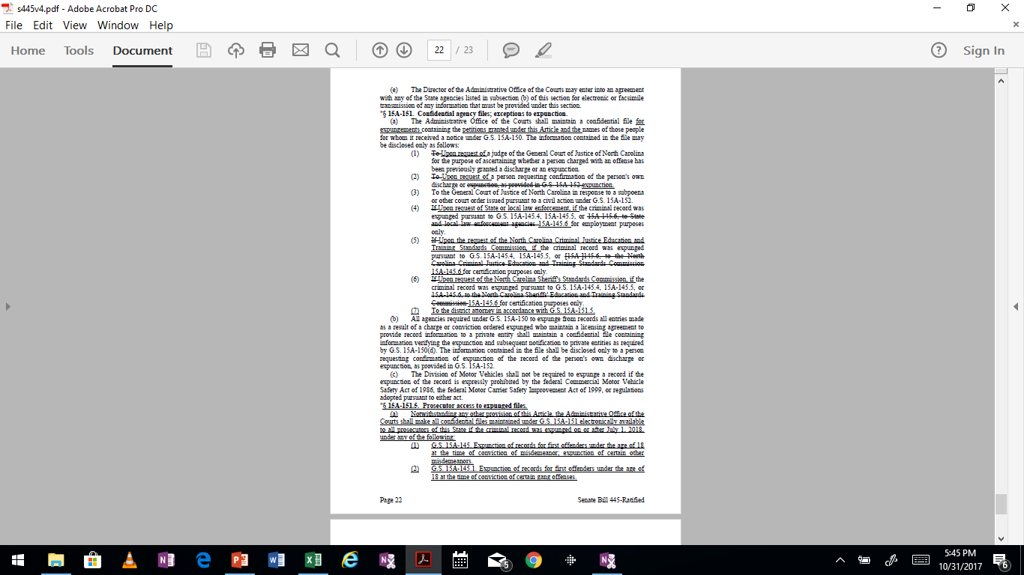
15A-151 Confidential agency files; exceptions to expunction

Slide 52
15A-151.5 Prosecutor access to expunged files
“Notwithstanding any other provision of this Article, the Administrative Office of the Courts shall make all confidential files maintained under G.S. 15A-151 electronically available to all prosecutors of this State if the criminal record was expunged on or after July 1, 2018, under any of the following:
G.S. 15A-145. Expunction of records for first offenders under the age of 18 at the time of conviction of misdemeanor; expunction of certain other misdemeanors.
G.S. 15A-145.1. Expunction of records for first offenders under the age of 18 at the time of conviction of certain gang offenses.
G.S. 15A-145.2. Expunction of records for first offenders not over 21 years of age at the time of the offense of certain drug offenses.
G.S. 15A-145.3. Expunction of records for first offenders not over 21 years of age at the time of the offense of certain toxic vapors offenses.
G.S. 15A-145.4. Expunction of records for first offenders who are under 18 years of age at the time of the commission of a nonviolent felony.
G.S. 15A-145.5. Expunction of certain misdemeanors and felonies; no age limitation.
G.S. 15A-145.6. Expunction for certain defendants convicted of prostitution.

Slide 53
15A-151.5 Prosecutor access to expunged files (continued)
(8) G.S. 15A-146(a). Expunction of records when charges are dismissed.
(9) G.S. 15A-146(a1). Expunction of records when charges are dismissed.
For any expungement granted on or after July 1, 2018, the expunged criminal records under subdivisions (1) through (7) of subsection (a) of this section may be used to calculate prior record level if the named person is convicted of a subsequent criminal offense.
For any expungement granted on or after July 1, 2018, the information maintained by the Administrative Office of the Courts, and made available under subsection (a) of this section, shall be prima facie evidence of the expunged conviction for purposes of calculating prior record level of the named person and shall be admissible into evidence at a subsequent criminal sentencing hearing.”

Slide 54
Certificates of Relief from Collateral Consequences 15A-173.1 through 15A-173.6 Resources:
https://nccriminallaw.sog.unc.edu/certificate-of-relief-from-collateral-consequences-of-a-criminal-conviction/

Slide 55
Certificates of Relief from Collateral Consequences 15A-173.1 through 15A-173.6
15A-173.2 Certificate of Relief
“(a) An individual who is convicted of no more than two Class G, H, or I felonies or misdemeanors in one session of court, and who has no other convictions for a felony or misdemeanor other than a traffic violation, may petition the court where the individual was convicted for a Certificate of Relief relieving collateral consequences as permitted by this Article. Except as otherwise provided in the subsection, the petition shall be heard by the senior resident superior court judge if the convictions were in superior court, or the chief district court judge if the convictions were in district court. The senior resident superior court judge and chief district court judge in each district may delegate their authority to hold hearings and issue, modify, or revoke Certificates of Relief to judges, clerks, or magistrates in that district.”

Slide 56
Certificates of Relief from Collateral Consequences 15A-173.1 through 15A-173.6
15A-173.2 Certificate of Relief
“(b) Except as otherwise provided in G.S. 15A-173.3, the court may issue a Certificate of Relief if, after reviewing the petition, the individual’s criminal record history, any information provided by a victim under G.S. 15A-173.6 or the district attorney, and any other relevant evidence, it finds the individual has established by a preponderance of the evidence all of the following:
(1) Twelve months have passed since the individual has completed his or her sentence. For purposes of this subdivision, and individual has not completed his or her sentence until the individual has served all of the active time, if any, imposed for each offense and has also completed any period of probation, post-release supervision, and parole related to the offense that is required by State law or court order.
(2) The individual is engaged in, or seeking to engage in, a lawful occupation or activity, including employment, training, education, or rehabilitative programs, or the individual otherwise has a lawful source of support.
(3) The individual has complied with all requirements of the individual’s sentence, including any terms of probation, that may include substance abuse treatment, anger management, and educational requirements.
(4) The individual is not in violation of the terms of any criminal sentence, or that any failure to comply is justified, excused, involuntary, or insubstantial.
(5) A criminal charge is not pending against the individual.
(6) Granting the petition would not pose an unreasonable risk to safety or welfare of the public or any individual.”

Slide 57
Certificates of Relief from Collateral Consequences 15A-173.1 through 15A-173.6
15A-173.2 Certificate of Relief
“(c) The Certificate of Relief shall specify any restriction imposed and collateral sanction or disqualification from which has not been granted under G.S. 15A-173.4(a).
(d) A Certificate of Relief relieves all collateral sanctions, except those listed in G.S. 15A-173.3, those sanctions imposed by the North Carolina Constitution or federal law, and any others specifically excluded in the certificate. A Certificate of Relief does not automatically relieve a disqualification; however, an administrative agency, governmental official, or court in a civil proceeding may consider a Certificate of Relief favorably in determining whether a conviction should result in disqualification.”
(e) A Certificate of Relief may be revoked pursuant to G.S. 15A-73.4(b) if the individual is subsequently convicted of a felony or misdemeanor other than a traffic violation or is found to have made any material misrepresentation in his or her petition.”

Slide 58
Certificates of Relief from Collateral Consequences 15A-173.1 through 15A-173.6
15A-173.3. Collateral sanctions not subject to order of limited relief or Certificate of Relief.
“A Certificate of Relief shall not be issued to relieve any of the following collateral sanctions:
(1) Requirements imposed by, and any statutory requirements or prohibitions imposed as a result of registration pursuant to, Article 27A of Chapter 14 of the General statutes.
(2) Prohibitions on possession of firearms imposed by Article 54A and 54B of Chapter 14 of the General Statutes.
(3) A motor vehicle license suspension, revocation, limitation, or ineligibility imposed pursuant to Chapter 20 of the General Statutes.
(4) Ineligibility for certification pursuant to Chapter 17C or 17E of the General Statutes.
(5) Ineligibility for employment as any of the following if the ineligibility is a sanction imposed by a statute or session law of North Carolina.
A. A corrections or probation officer.
B. A prosecutor or investigator in either the Department of Justice or in the office of a district attorney. For purpose of this subdivision, the term district attorney shall include any district attorney authorized pursuant to G.S. 7A-60”

Slide 59
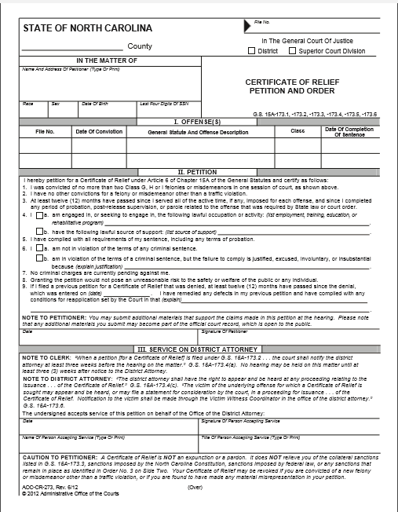
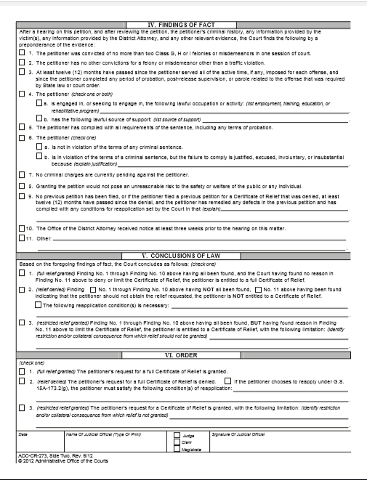
Certificates of Relief from Collateral Consequences 15A-173.1 through 15A-173.6 AOC-CR-273---Petition and Order

Slide 60
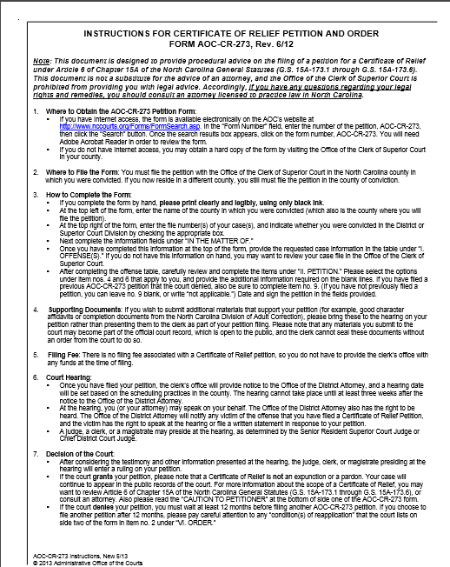
Certificates of Relief from Collateral Consequences 15A-173.1 through 15A-173.6 Instructions for Certificate of Relief Form AOC-CR-273

Slide 61
Motions for Appropriate Relief 15A-1411 through 15A-1422
ADDITIONAL RESOURCES:
https://www.sog.unc.edu/resources/microsites/relief-criminal-conviction/motions-appropriate-relief
https://benchbook.sog.unc.edu/criminal/motions-appropriate-relief

Slide 62
Motions for Appropriate Relief 15A-1411 through 15A-1422
Procedure for motion is found in G.S. 15A-1420
15A-1413(d) provides that:
“All motions for appropriate relief filed in superior court shall, when filed, be referred to the senior resident superior court judge, who shall assign the motion as provided by this section for review and administrative action, including, as may be appropriate, dismissal, calendaring for hearing, entry of a scheduling order for subsequent events in the case, or other appropriate actions.”
“All motions for appropriate relief filed in district court shall, when filed, be referred to the chief district court judge, who shall assign the motion as provided by this section for review and administrative action, including, as may be appropriate, dismissal, calendaring for hearing, entry of a scheduling order for subsequent events in the case, or other appropriate actions.”
Motion is filed with the Clerk of Superior Court and served on District Attorney pursuant to G.S. 15A-1420 (b1)1

Slide 63
Motions for Appropriate Relief 15A-1411 through 15A-1422
15A-1414—Motion by defendant for appropriate relief made within 10 days after verdict
15A-1414(b):
“Unless included in G.S. 15A-1415, all errors, including but not limited to the following, must be asserted within 10 days after entry of judgment:
(1) Any error of law, including the following:
A. The court erroneously failed to dismiss the charge prior to trial pursuant to G.S. 15A-954.
B. The court’s ruling was contrary to law with regard to motions made before or during the trial, or with regard to the admission or exclusion of evidence.
C. The evidence, at the close of all the evidence, was insufficient to justify submission of the case to the jury, whether or not a motion so asserting was made before verdict. The court erroneously instructed the jury.
(2) The verdict is contrary to the weight of the evidence.
(3) For any other cause the defendant did not receive a fair and impartial trial.
(4) The sentence imposed on the defendant is not supported by evidence introduced at the trial and sentencing hearing. This motion must be addressed to the sentencing judge.

Slide 64
Motions for Appropriate Relief §15A-1411 through 15A-1422
15A-1415 --Grounds for appropriate relief which may be asserted by defendant after verdict; limitation as to time.
15A-1415 (b) “The following are the only grounds which the defendant may assert by a motion for appropriate relief made more than 10 days after entry of judgment:
(1) The acts charged in the criminal pleading did not at the time they were committed constitute a violation of criminal law.
(2) The trial court lacked jurisdiction over the person of the defendant or over the subject matter.
(3) The conviction was obtained in violation of the Constitution of the United States or the Constitution of North Carolina.
(4) The defendant was convicted or sentenced under a statute that was in violation of the Constitution of the United States or the Constitution of North Carolina.
(5) The conduct for which the defendant was prosecuted was protected by the Constitution of the United States or the Constitution of North Carolina.
(6) Repealed…..
(7) There has been a significant change in law, either substantive or procedural, applied in the proceedings leading to the defendant’s conviction or sentence, and retroactive application of the changed legal standard is required.
(8) The sentence imposed was unauthorized at the time imposed, contained a type of sentence disposition or a term of imprisonment not authorized for the particular class of offense and prior record or conviction level was illegally imposed, or is otherwise invalid as a matter of law. However, a motion for appropriate relief on the grounds that the sentence imposed on the defendant is not supported by evidence introduced at the trial and sentencing hearing must be made before the sentencing judge.
(9) The defendant is in confinement and is entitled to release because his sentence has been fully served.
(10) The defendant was convicted of a first offense of prostitution under G.S. 14-204, and the court did not discharge the defendant and dismiss the charge pursuant to G.S. 14-204(b); the defendant’s participation in the offense was a result of having been a victim of human trafficking under G.S. 14-43.11, sexual servitude under G.S. 14-43.13, or the federal Trafficking Victims Protection Act (22 U.S.C. §7102(13)); and the defendant seeks to have the conviction vacated.”

Slide 65
Motions for Appropriate Relief §15A-1411 through 15A-1422
15A-1415 (c)
“Notwithstanding the time limitations herein, a defendant at any time after verdict may by a motion for appropriate relief, raise the ground that evidence is available which was unknown or unavailable to the defendant at the time of trial, which could not with due diligence have been discovered or made available at that time, including recanted testimony, and which has a direct and material bearing upon the defendant’s eligibility for the death penalty or the defendant’s guilt or innocence. A motion based upon such newly discovered evidence must be filed within a reasonable time of its discovery.”
15A-1415 (f)
“In the case of a defendant who is represented by counsel in postconviction proceedings in superior court, the defendant’s prior trial or appellate counsel shall make available to the defendant’s counsel their complete files relating to the case of the defendant. The State, to the extent allowed by law, shall make available to the defendant’s counsel the complete files of all law enforcement and prosecutorial agencies involved in the investigation of the crimes committed or the prosecution of the defendant. If the State has a reasonable belief that allowing inspection of any portion of the files by counsel for the defendant would not be in the interest of justice, the State may submit for inspection by the court those portions of the files so identified. If upon examination of the files, the court finds that the files could not assist the defendant in investigating, preparing, or presenting a motion for appropriate relief, the court in its discretion may allow the State to withhold that portion of the files.”

Slide 66
Motions for Appropriate Relief §15A-1411 through 15A-1422
15A- 1416.1---Motion by the defendant to vacate prostitution conviction for sex trafficking victim.
15A-1416.1(a) provides: “A motion for appropriate relief seeking to vacate a conviction for prostitution based on the grounds set out in G.S. 15A-1415(b)10 shall be filed in the court where the conviction occurred….”

Slide 67
Motions for Appropriate Relief §15A-1411 through 15A-1422
Filing a Motion for Appropriate Relief:
15A-1420—Motion for appropriate relief; procedure.
“(a) Form, Service, Filing.----
(1) A motion for appropriate relief must:
A. Be made in writing unless it is made:
In open court;
Before the judge who presided at trial;
Before the end of session if made in superior court; and
Within 10 days after entry of judgment;
(b) State the grounds for the motion;
(c) Set for the relief sought;
(c1.) If the motion for appropriate relief is being made in superior court and is being made by an attorney, the attorney must certify in writing that there is a sound legal basis for the motion and that it is being made in good faith; and that the attorney has notified both the district attorney’s office and the attorney who initially represented the defendant of the motion; and further, that the attorney has reviewed the trial transcript or made a good-faith determination that the nature of the relief sought in the motion does not require that the trial transcript be read in its entirety. In the event that the trial transcript is unavailable, instead of certifying that the attorney has read the trial transcript, the attorney shall set forth in writing what efforts were undertaken to locate the transcript; and
(d) Be timely filed.

Slide 68
Motions for Appropriate Relief §15A-1411 through 15A-1422
Filing a Motion for Appropriate Relief:
15A-1420—Motion for appropriate relief; procedure (continued)
(3) A written motion for appropriate relief must be filed in the manner provided by G.S. 15A-951(c).
(4) An oral or written motion for appropriate relief may not be granted in district court without the signature of the district attorney, indicating that the State has had an opportunity to consent or object to the motion. However, the court may grant a motion for appropriate relief without the district attorney’s signature 10 business days after the district attorney has been notified in open court of the motion, or served with the motion pursuant to G.S. 15A-951(c).
(5) An oral or written motion for appropriate relief made in superior court and made by an attorney may not be granted by the court unless the attorney has complied with the requirements of sub-division c1. of subdivision (1) of this subsection.”

Slide 69
Motions for Appropriate Relief §15A-1411 through 15A-1422
Filing a Motion for Appropriate Relief:
15A-1420 (a)—Motion for appropriate relief; procedure (continued)
“(2) A written motion for appropriate relief must be served in the manner provided in G.S. 15A-951(b). When a motion for appropriate relief is permitted to be made orally the court must determine whether the matter may be heard immediately or at a later time. If the opposing party, or his counsel if he is represented, is not present, the court must provide for the giving of adequate notice of the motion and the date of hearing to the opposing party, or his counsel if he is represented by counsel.
(3) A written motion for appropriate relief must be filed in the manner provided by G.S. 15A-951(c).
(4) An oral or written motion for appropriate relief may not be granted in district court without the signature of the district attorney, indicating that the State has had an opportunity to consent or object to the motion. However, the court may grant a motion for appropriate relief without the district attorney’s signature 10 business days after the district attorney has been notified in open court of the motion, or served with the motion pursuant to G.S. 15A-951(c).
(5) An oral or written motion for appropriate relief made in superior court and made by an attorney may not be granted by the court unless the attorney has complied with the requirements of sub-division c1. of subdivision (1) of this subsection.”

Slide 70
Motions for Appropriate Relief §15A-1411 through 15A-1422
Filing a Motion for Appropriate Relief:
15A-1420—Motion for appropriate relief; procedure (continued)
“(b) Supporting Affidavits.—
(1) A motion for appropriate relief made after the entry of judgment must be supported by affidavit or other documentary evidence if based upon the existence or occurrence of facts which are not ascertainable from the records and any transcript of the case or which are not within the knowledge of the judge who hears the motion.
(2) The opposing party may file affidavits or other documentary evidence.”

Slide 71
Motions for Appropriate Relief §15A-1411 through 15A-1422
Filing a Motion for Appropriate Relief:
15A-1420—Motion for appropriate relief; procedure (continued)
“(e) Nothing in this section shall prevent the parties to the action from entering into an agreement for appropriate relief, including an agreement as to any aspect, procedural or otherwise, of a motion for appropriate relief.”

Slide 72
Motions for Appropriate Relief §15A-1411 through 15A-1422
Link to Sample District Court Motions for Appropriate Relief:
http://www.ncids.org/motionsbanknoncap/districtcourt/motionsforappropriaterelief.pdf

Slide 73
Juvenile Expunctions 7B-3200 through 7B-3202
Additional Resources:
https://www.sog.unc.edu/resources/microsites/relief-criminal-conviction/expunctions-delinquency-matters
https://ncjuveniledefender.com/2015/08/06/new-materials-expunction-toolkit/

Slide 74
Juvenile Expunctions §7B-3200 through 7B-3202
7B-3200
“(a) Any person who has attained the age of 18 years may file a petition in the court where the person was adjudicated undisciplined for expunction of all records of that adjudication.
(b) Any person who has attained the age of 18 years may file a petition in the court where the person was adjudicated delinquent for expunction of all records of that adjudication provided:
(1) The offense for which the person was adjudicated would have been a crime other than a Class A, B1, B2, C, D, or E felony if committed by an adult.
(2) At least 18 months have elapsed since the person was released from juvenile court jurisdiction, and the person has not subsequently been adjudicated delinquent or convicted as an adult of any felony or misdemeanor other than a traffic violation under the laws of this State or any other State.”

Slide 75
Juvenile Expunctions §7B-3200 through 7B-3202
§7B-3200
“(h) Any person who was alleged to be delinquent as a juvenile and has attained the age of 16 years, or was alleged to have be undisciplined as a juvenile and has attained the age of 18 years, may file a petition in the court in which the person was alleged to be delinquent or undisciplined, for expunction of all juvenile records of the juvenile having been alleged to be delinquent or undisciplined if the court dismissed the juvenile petition without adjudication that the juvenile was delinquent or undisciplined.”

Slide 76
Juvenile Expunctions §7B-3200 through 7B-3202
§7B-3201
“(a) Whenever a juvenile’s record is expunged, with respect to the matter in which the record was expunged, the juvenile who is the subject of the record and the juvenile’s parent may not be held thereafter under any provision of any laws to be guilty of perjury or otherwise giving false statement by reason of the person’s failure to recite or acknowledge such record or response to any inquiry made of the person for any purpose.
(b) Notwithstanding subsection (a) of this section, in any delinquency case if the juvenile is the defendant and chooses to testify or if the juvenile is not the defendant and is called as a witness, the juvenile may be ordered to testify with respect to whether the juvenile was adjudicated delinquent.”

Slide 77
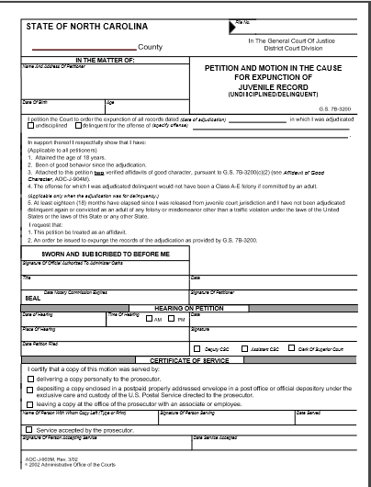
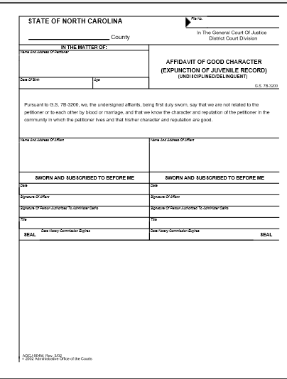
Juvenile Expunctions--- AOC-J-903M & AOC-J-904M 7B-3200 through 7B-3202

Slide 78
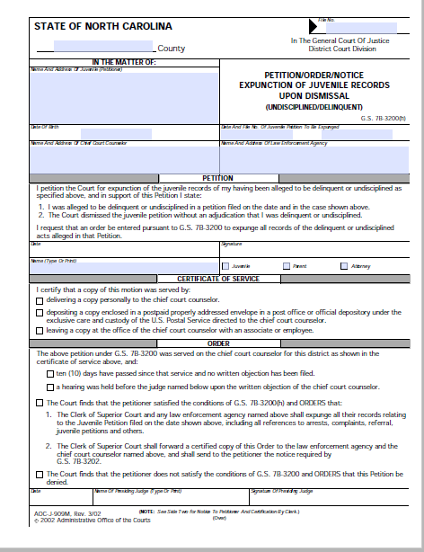
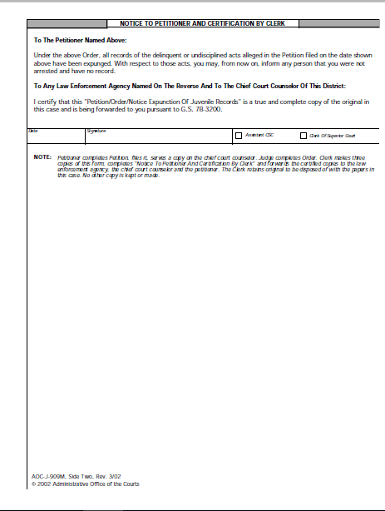
Juvenile Expunctions--------------------AOC-J-909M 7B-3200 through 7B-3202

Slide 79
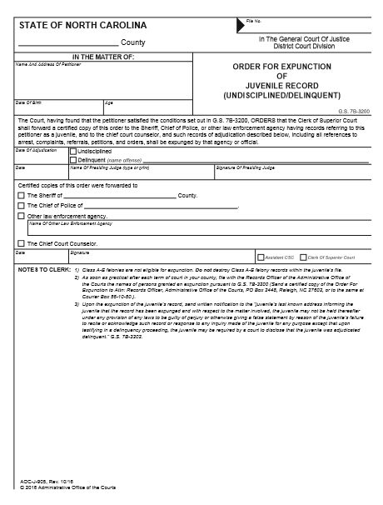
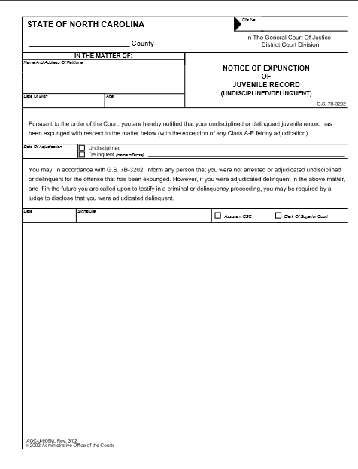
Juvenile Expunctions----------AOC-J-905M & AOC-J-906M 7B-3200 through 7B-3202 ORDERS & NOTICE

Slide 80
Juvenile Expunctions §7B-3200 through 7B-3202
7B-2512. Dispositional Order.
“(b) The court shall include information at the time of issuing the dispositional order, either orally in court or in writing, on the expunction of juvenile records as provided for in G.S. 7B-3200 that are applicable to the dispositional order.”

Slide 81
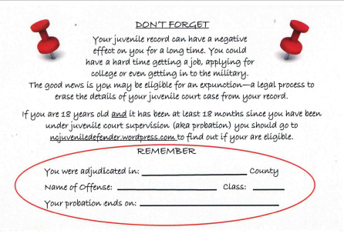
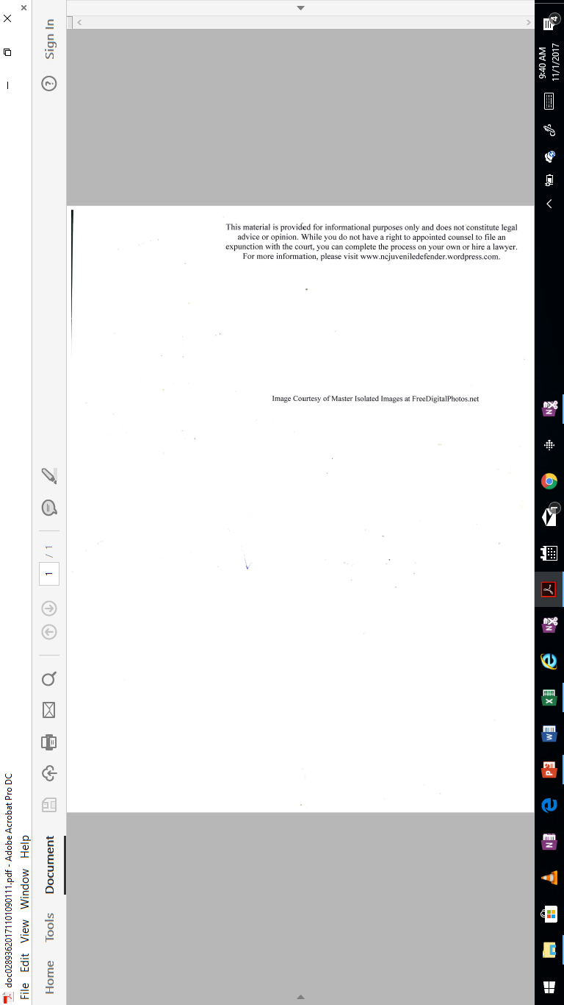
Juvenile Expunctions §7B-3200 through 7B-3202

Slide 82
Questions? M. LeAnn Melton Chief Public Defender for Buncombe County Email: m.leann.melton@nccourts.org

